Slide 1
P56 - Benchmark Commercial AI Product for Medical Imaging Services Provider
Project Name: Benchmarking Commercial AI-ISYS3888
Project Period: 2022/8 - 2022/12
Sponsor(s) Client: Professor Simon Poon
Organisation: USYD
Project Supervisor: Yaoqi Huang
Class Time: Tuesdays 3:00pm-5:00pm
Kiran Papalkar 490411205 kpap8603
Bronte Lee 490420056 blee6992
Benjamin Men 500401903 jmen0495
Zheyuan Zhang 500023392 zzha3548
Cailin Feldman 480439062 cfel2589
Andersen Liu 480022439 bliu3122(Other group name: SOFT3888_TU12_01(RE), project name: P08 - WeBike)
Zichen Li 500174041 zili4471 (Other group name: SOFT3888_W16_02(REMOTE), project name: P25 - Travel plan and diary application)

Slide 2
Introduction of Project and Stakeholders
Introduction:
The basis of this project is in identifying CAD products to be used in tuberculosis detection, we will be crafting a recommendation report to present to ABC in order to identify the most appropriate product for their needs by analysing available technical and user data.
Stakeholders:
ABC
Dr. Xavier Ray (Chief Radiologist Information Officer)
Chuck To (Chief Technology Officer)
Our team
Simon Poon (Client)

Slide 3
Scope Of The Project
AI + radiologists = modern radiology practice
Performance = sensitivity + accuracy + validity + etc.
A better AI project = performance + UX
We will split the project into two subgroup- evaluate ai performance and user experience.
With effective communication and well arranged tasks, we will research ai for the medical imaging industry and give evaluation reports.
Notes:
Today AI products are widely used in radiology clinics. As medical technology companies develop, more and more technology products (AI) can detect TB. Then the question of which products can better serve radiologists becomes a question to be studied.
Different products have different performances (sensitivity, accuracy, validity, etc.), so we need to use a systematic review and meta-analysis to analyze which product is best. We also need to benchmark the different products to determine which product has more user experience advantages. Combining product performance and user experience, we recommend the most suitable products for our customers.

Slide 4
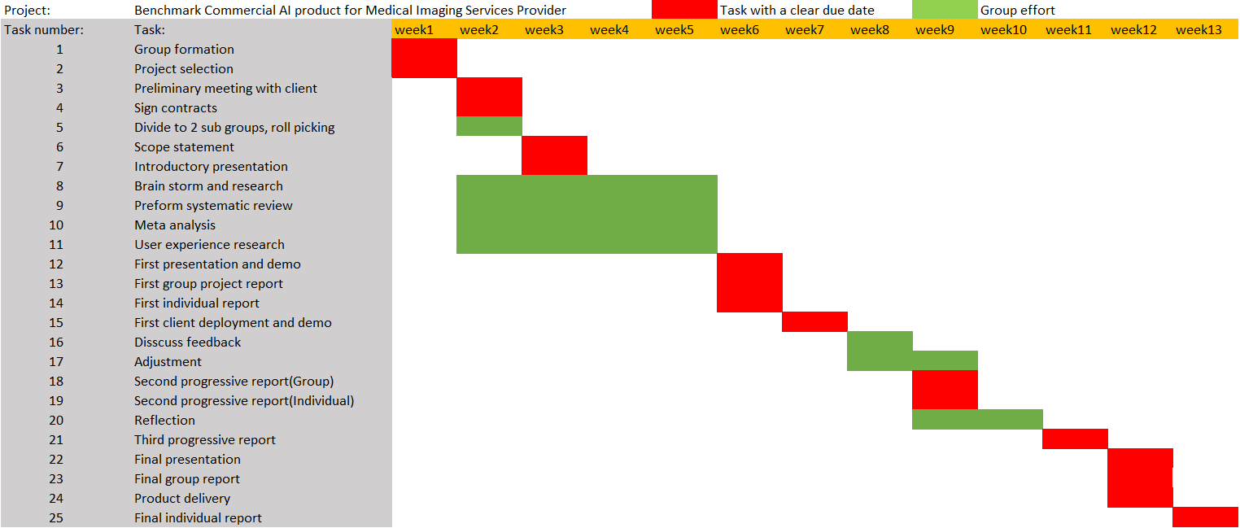
Timeline

Slide 5
Member Responsibilities
Week | Tracker | Manager | Customer Liaison | Programmer | Tester | Doomsayer
2 | Edward Li | Benjamin Men | Cailin Feldman | Bronte Lee, Kiran Papalkar | Zheyuan Zhang | Baoxi Liu
3 | Baoxi Liu | Edward Li | Cailin Feldman | Bronte Lee, Kiran Papalkar | Benjamin Men, | Zheyuan Zhang
4 | Zheyuan Zhang | Baoxi Liu | Cailin Feldman | Bronte Lee, Kiran Papalkar | Edward Li | Benjamin Men
5 | Benjamin Men | Zheyuan Zhang | Cailin Feldman | Bronte Lee, Kiran Papalkar | Baoxi Liu | Edward Li

Slide 6
Expected outcomes and deliverables
Outcomes
Benchmark AI products that diagnose TB using diagnostic test accuracy
Investigate user experience of AI products used for medical diagnosis and identify factors affecting user acceptance
Provide a recommendation of which product is best based on accuracy and user experience
Deliverables
Progress report and presentation:
Systematic review
Initial meta-analysis of diagnostic test accuracy and user experience
Final report and presentation:
Systematic review
Completed meta-analysis of diagnostic test accuracy and user experience
Discussion and recommendation of a product
Notes:
Our project has three expected outcomes. First is that we will benchmark multiple certified, commercial AI products that diagnose TB using diagnostic test accuracy. The second is an investigation to synthesise user experience of using these products and identify factors which affect user acceptance. Third is a recommendation of which product or products are the best based on the diagnostic test accuracy benchmarks and user experience and identification of any possible areas of improvement.
Our project has two major deliverables, a progress report and accompanying presentation and a final report and accompanying presentation. The progress report will contain a systematic review of relevant studies using the PRISMA method. It will also have an initial meta-analysis, comparing at least 2 products for diagnostic test accuracy and 2 studies for user experience. The final report will contain the systematic review, a completed meta-analysis and a discussion of meta-analyses findings, resulting in a recommendation of which product or products are best.

